Slide 1
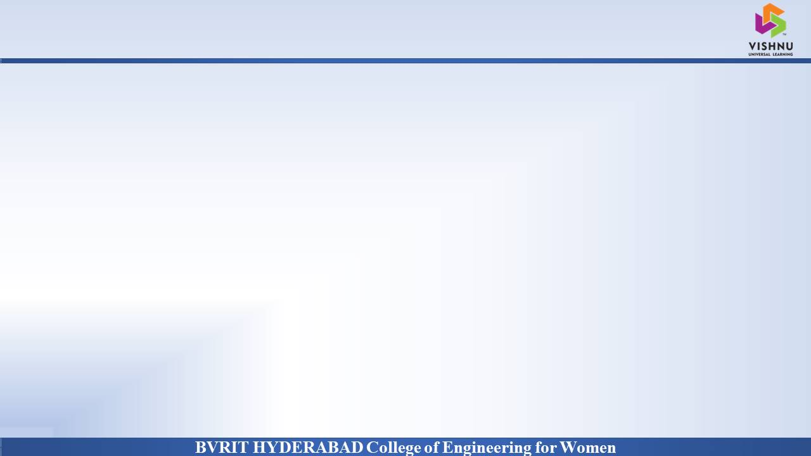
Department of Computer Science and Engineering
SCHOOL MANAGEMENT SYSTEM
Date: 08 April 2021
K.Siri Satwika : 17WH1A05B3
A.Sri Nitya : 17WH1A0578
S.Saharsha : 17WH1A0572
Internal Guide: Ms. Suparna Das Designation : Assistant Professor

Slide 2

Abstract
Why Should I Study this course?
School Management System helps to get the most accurate information to make more effective decisions. Teachers and headmasters gain time saving administrative tools, parents gain immediate access to their children’s grades and students can track their own progress. School Management System equipped features makes it possible to generate schedules and reports in minutes and to retrieve attendance records, grade checks, report cards, transcripts, and form letters in just a few clicks.
School Management Systems helps Teachers to complete grade book, track students attendance, input class notes, create lesson plans and detailed reports.
Examples
BVRIT HYDERABAD College of Engineering for Women

Slide 3
System Requirements
Why Should I Study this course?
Environment | Specifications
Hardware | Processor: Intel Core i5 @ 1.60 GHz
 | RAM: 8 GB
 | Hard Disc: 240 GB
Software | XAMPP 1.8.2 ,MySQL Server
 | Operating System: Windows 10
 | Browser: Google Chrome,Internet Explorer
Examples
BVRIT HYDERABAD College of Engineering for Women

Slide 4
Timeline
Why Should I Study this course?
Review | Excepted Completion
Review 0 | Requirements Specification Details of Features Base paper and references
Review 1 | Partial implementation of the features
Review 2 | Complete Implementation Report for the Project
Examples
BVRIT HYDERABAD College of Engineering for Women

Slide 5
References
Why Should I Study this course?
[1] D. Zhibing Liu, Huixia Wang, Hui Zan “Design and implementation of student information management system.” 2010 International Symposium on intelligence information processing and trusted computing.
[2] S. R.Bharmagoudar, Geeta R.B and S.G. Totad, “Web based student management system.”, Andra Pradesh, vol.2 June 2013.
[3] M.A.Norasiah and A.Norhayti “Intelligent student information system.”, 4th International conference on telecommunication technology proceedings. Shah Alam, Malaysia, 0-7803-7773-7/03 2013 IEEE
[4]CAI Chang-an, WaNG Qi, “Design and implementation of student information management system based on B/S model”, computer engineering and design, Beijing, 2012.
Examples
BVRIT HYDERABAD College of Engineering for Women

Slide 6
Thankyou

